Slide 1
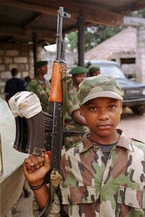
The effect of war on children
by: Wilmar Martinez

Slide 2
Introduction
War… its a topic that everybody is familiar with. But nobody knows what war is until you see it with ur own eyes… the effect the war is real hard for adults but nobody ever see’s how it affects children..Take the effect tht war leaves on adults and multiply that by 100 times thats what a child suffers.

Slide 3
Emotional effect when child attends war.
For a child to attend war is simply the most horrifying thing ever…. emotionally the child is still developing his body and mentality and for the mentality to me changed from an innocent child to a killing machine.
After war the child will never be the same.

Slide 4
emotional effect for child when parent goes to war.
For a child one of the most difficult things there is, is saying goodbye to your father and not knowing if he will come back or not…
In a child the emotional effect will be harder to overcome then for an adult.
When a child’s father goes to war there is a significant effect in the child emotional he seems to fall in depression and much more other things

Slide 5
physical effect
kids have been affected by war especially kids that have been kidnapped and put to fight in Sierra Leone's civil war.
Kids were drugged and physically abused and girls were sexually abused. this leaves a big trauma in the child's mentality that will be very difficult to overcome.

